Slide 1

Updated Risk Management Forms

Slide 2
Updated Risk Management Forms
Updated Reporting Forms
All forms are being updated to include the new bureau name
Risk Management forms that are being updated:
  KDHE Risk Management Plan Checklist
  Facility or Individual Report of Adverse Finding
  Confidential Quarterly Report
Other changes to these forms will be noted in the following slides
Notes:
Since all forms had to be updated in order to include the new bureau’s name, we made some other necessary changes to the RM forms as well.

Slide 3
Updated Risk Management Forms
Updated Reporting Forms
KDHE Risk Management Plan Checklist
Bureau name was updated on page 1
Formatting adjusted to allow more room for Risk Management Plan Year on page 1
Some elements were updated to match the exact verbiage from the affiliated statute or regulation

Slide 4
Updated Risk Management Forms
Updated Reporting Forms
Facility or Individual Report of Adverse Finding
“(Must include final SOC determination)” to the “description of incident” area
  This was added because most reports that are received do not include the actual SOC determination
“(If known)” was removed from the corrective action area
  This was added because the corrective action should be included on the report

Slide 5
Updated Risk Management Forms
Updated Reporting Forms
Confidential Quarterly Report
There are several changes to this report in order to:
    Collect all information required by KSA 65-4923(d)
      Each review and executive committee referred to in subsection (a) shall submit to the Secretary of Health and Environment, on a form promulgated by such agency, at least once every three months, a report summarizing the reports received pursuant to subsections (a)(2) and (a)(3) of this section. The report shall include the number of reportable incidents reported, whether an investigation was conducted, and any action taken.
    Collect more accurate information about each reportable incident

Slide 6
Updated Risk Management Forms
Updated Reporting Forms
Confidential Quarterly Report
The changes will allow KDHE to track each SOC III and SOC IV determination individually and know:
    Which licensing agency each SOC III or SOC IV was reported to
    What the category type was for each SOC III and SOC IV
    What corrective action was taken for each SOC III and SOC IV

Slide 7
Updated Risk Management Forms
Updated Reporting Forms
Confidential Quarterly Report Continued
Page 1:
  This will continue to be the confidential cover page
  Formatting was changed to increase the space for the facility’s name
  The report asks for the facility’s state license number (instead of the CCN)

Slide 8
Updated Risk Management Forms
Updated Reporting Forms
Confidential Quarterly Report Continued
Page 2:
  Formatting was changed to increase the space for the facility’s name
  The report asks for the facility’s state license number (instead of the CCN)
  The selection boxes for section 1 (Facility Type) and section 2 (Reporting Quarter) are now on the same side of the selection criteria
  Section 3 (UPDATED) now has a space to enter the IRNs for each final SOC III and final SOC IV determination made within the quarter

Slide 9
Updated Risk Management Forms
Updated Reporting Forms
Confidential Quarterly Report Continued
Page 2 continued:
  Section 4 (NEW) is now a check box to indicate that an investigation was conducted for each reportable incident listed in section 3
  Section 5 is now the area to indicate which licensing agencies each final SOC III and final SOC IV determination was submitted to (previously section 4)

Slide 10
Updated Risk Management Forms
Updated Reporting Forms
Confidential Quarterly Report Continued
Page 3:
  Section 6 (previously section 5) is now the area to enter the category type for each final SOC III and final SOC IV reported in section 3
  You will now be able to enter how many events there were for each category type along with the corresponding IRN(s) for each

Slide 11
Updated Risk Management Forms
Updated Reporting Forms
Confidential Quarterly Report Continued
Page 4:
  Section 7 (NEW) is the area to enter the corrective action taken for each final SOC III and final SOC IV reported in section 3
  You will now be able to enter how many events there were for each corrective action along with the corresponding IRN(s) for each
  This page also contains the information for how to submit the report to KDHE, a table that shows quarterly report due dates, and a section for additional notes

Slide 12
Updated Risk Management Forms
Updated Reporting Forms
Forms can be found at https://www.kdhe.ks.gov/580/Medical-Care-Facilities
Current forms must be used for all reporting

Slide 13
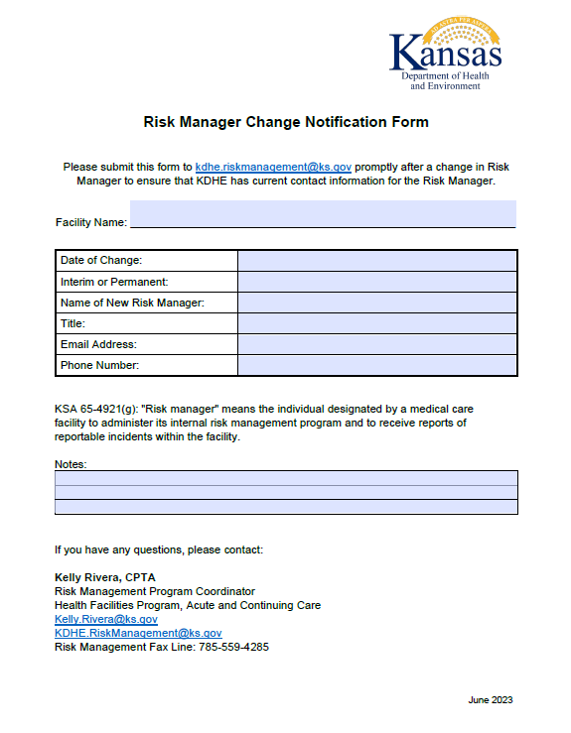
NEW Risk Management Form
Risk Manager Change Notification Form
There is now an official form for notifying
KDHE of a change in Risk Manager!

Slide 14

Updated Risk Management Forms
Questions?
Please contact Kelly Rivera, Risk Management Program Coordinator kdhe.riskmanagement@ks.gov

