Slide 1
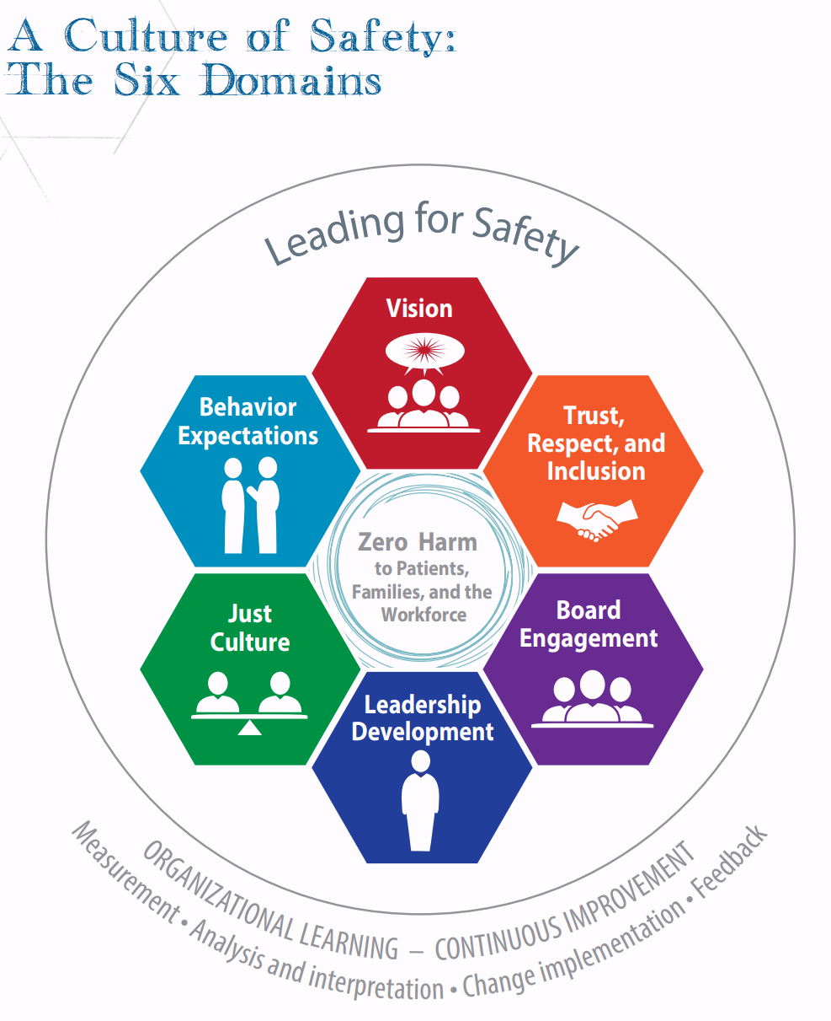
Potentially Conflicting Expectations
Healthcare Field Expectation for Culture of Safety
CMS – Patient Safety Structural Measure (PPS)
  Domain 2 Attestation – “Our hospital implemented written policies and protocols …. Reflects the distinction between human error, at-risk behavior, and reckless behavior”
State Statutes §§ 65-4921 to 65-4923
  Defines Risk Management and describes RM program, plan, reporting and confidentiality
KDHE Regulations K.A.R. 28-52-4
  RM Categories “shall be in the substantially the following form: (1) Standards of care met;
  (2) Standards of care not met, but with no...
  (3) Standards of care not met, with injury…
  (4) Possible grounds for disciplinary action
Leading_a_Culture_of_Safety_Blueprint.pdf
Institute for Healthcare Improvement and National Patient Safety Foundation

Slide 2
Citations
Health Care and Life Safety
2025

Slide 3
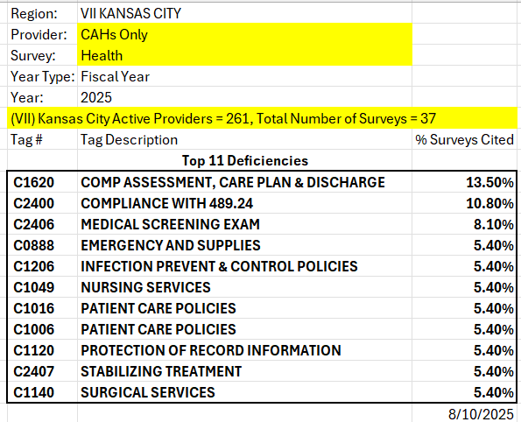

Slide 4
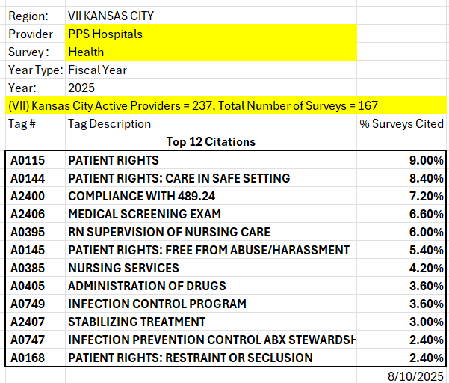

Slide 5
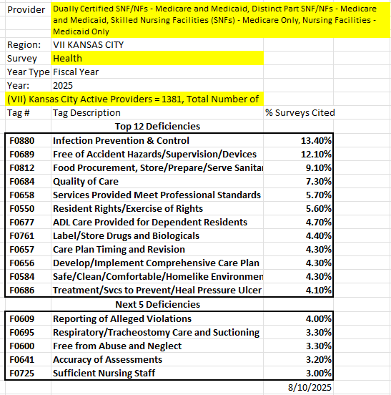

Slide 6
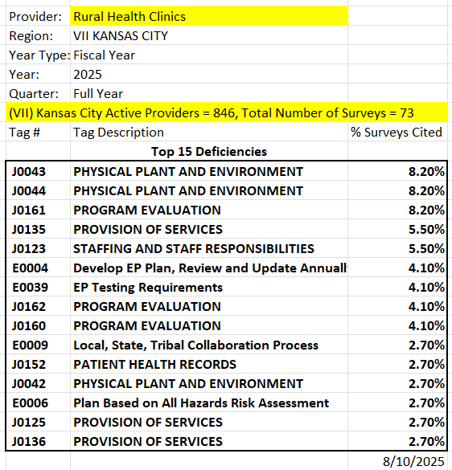

Slide 7
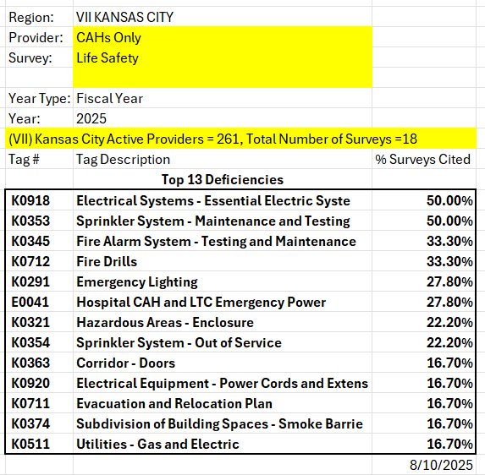

Slide 8
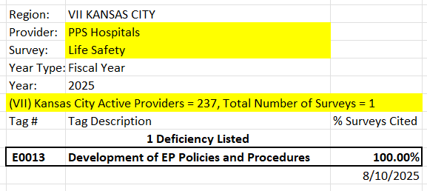

Slide 9
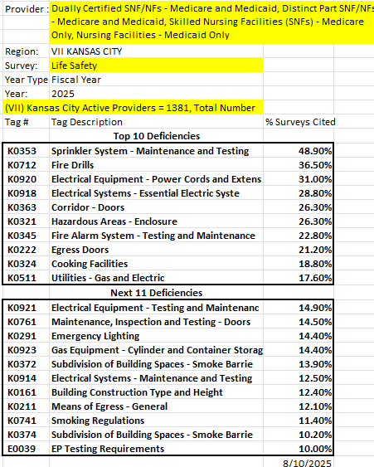

Slide 10
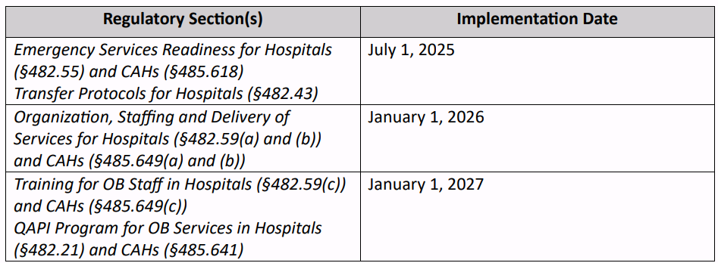
OB and ER Readiness - 2025 OPPS OB, ER and Transfer COPs (4-30-25) (6).pdf
AIM Obstetric Emergency Readiness Resource Kit
OB Networking Group Webinars – Aug. 19 @ 10 am and Sept. 9th @ 10 am
SHN/KU SOM RMOMS, KPQC, PHN/KU Care Collaborative

